Slide 1
Partnership Working Across SCQF
Sarah Abenheimer: Depute Head Teacher, Nairn Academy
Louise Martin-Theyers: Access & Progression Manager, UHI Inverness

Slide 2
Where Learning Means More
Notes:
Nairn High School demographics – how many on role, type of students etc?
30 & 36% go onto HE
The rest are FE and employment
Employers in the area is care sector – retirement capital of NE Scotland
Schools focus on exam based courses which don’t meet the needs of learners - SCQF allows us to fill that gap
UHI Inverness, tertiary setting offering courses SCQF Level 1 to level 12

Slide 3
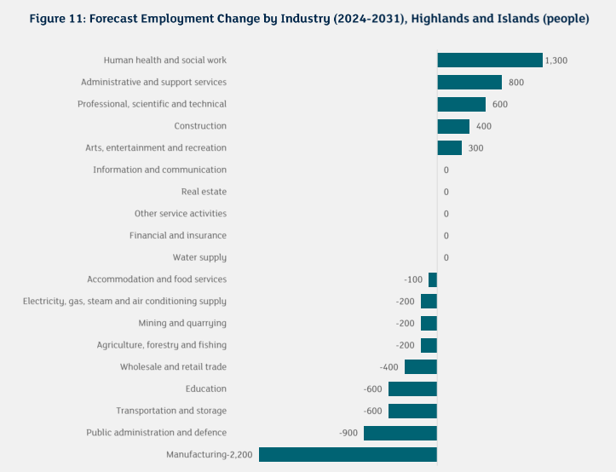
The Start of the Journey
What do pupils need?
How do we provide it?
Creative thinking and the value of partnership working
Notes:
Sarah

Slide 4
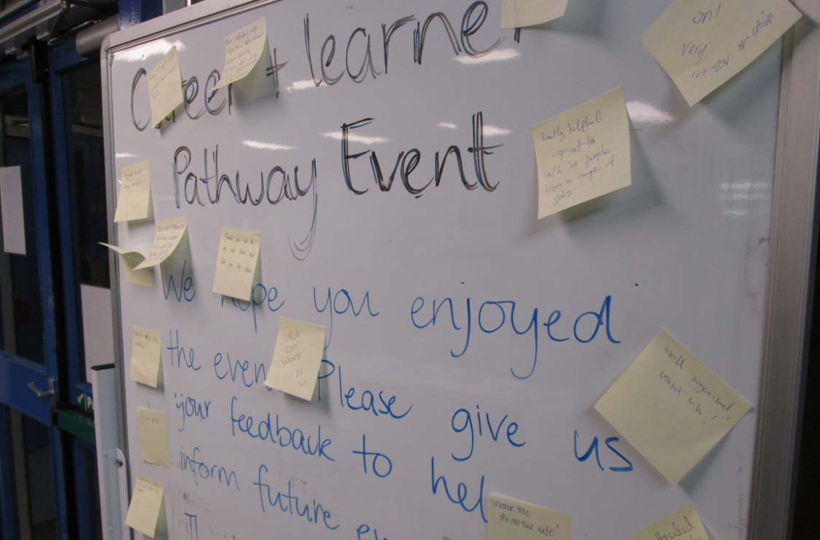
The Start of the Journey
The need to recognise and capture wider achievement in a formal way
Increase the number of tariff points pupils gain before leaving school
Broadening the curriculum to recognise employability, community endeavour and life skills
Notes:
Sarah

Slide 5
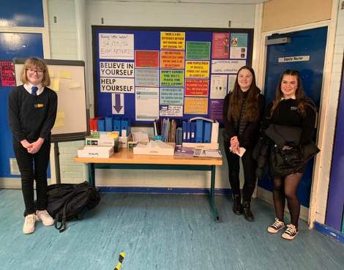
3 New Award Qualifications
SCQF level 3 Learning a New Skill
SCQF Level 5 From Seed to Sale
SCQF Level 5 Community project
Notes:
Sarah

Slide 6
Award Development
School identify a curriculum idea
Quality officers at UHI work directly with school teams to develop SCQF award specification and assessment
Ensure SCQF level descriptors met
Training session with SCQF – understanding level descriptors and use of language
School write the outcomes
Quality team ensure SCQF requirements met
Notes:
Louise

Slide 7
Quality Assurance
Define Aims of the Programme
Confirm Learning Outcomes
Decide Assessment Methods
Allocate and SCQF Level
Estimate SCQF Credit Points
Confirm Quality Assurance Process & Procedures
Submit Proposal to a Credit Rating Body
UHI Inverness – Undertake Quality Assurance Process
Approval Panel – comprises Head of Curriculum School, Curriculum managers, Quality team, Lecturers in unrelated areas, Professional Service leads
Notes:
Louise

Slide 8
Timetabling & Course Choices
2 single periods per week with entire S6 cohort
2 awards in these periods Community Project at Level 5 and SQA work experience award at Level 6
Meet with every pupil on a regular basis to make sure they are on track with overall studies in school and to check progress on the 2 work booklets
All course choices are listed against the SCQF Framework
SCQF listing from Level 2&3 to 5 &6
Make Loom videos to explain the framework
Events to explain the framework to parents
Large Career and Learner Pathway event every year
Notes:
Sarah

Slide 9
Outcomes

Slide 10
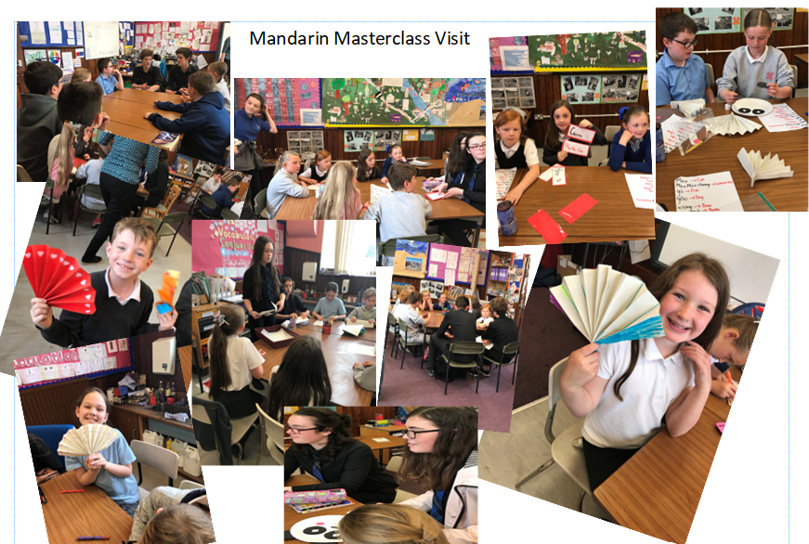
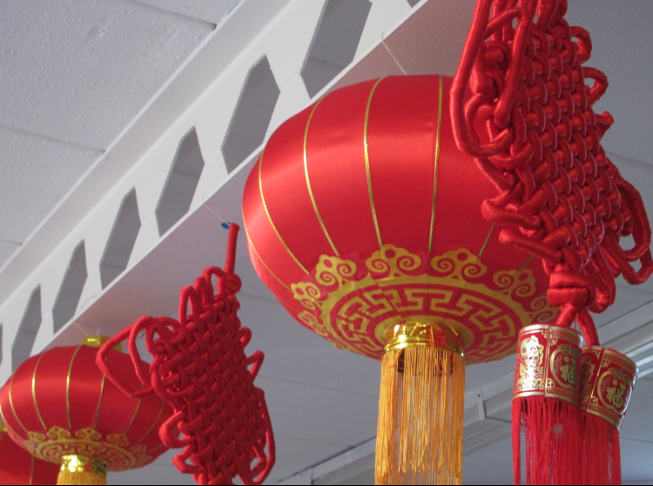
Learning a New Skill
SCQF Level 3
.
Notes:
Sarah

Slide 11
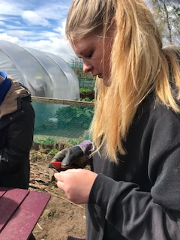
Learning a New Skill
SCQF Level 3
.
Notes:
Sarah

Slide 12
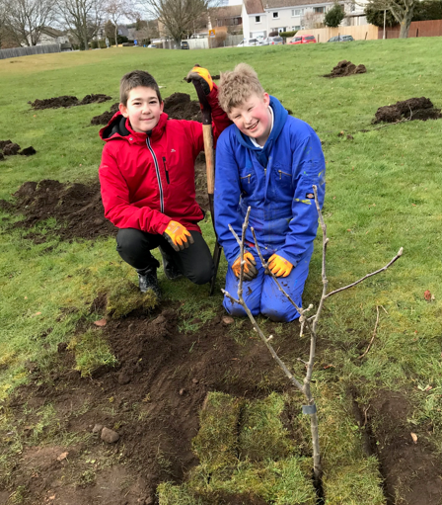
Learning a New Skill
SCQF Level 3
Notes:
Sarah

Slide 13
From Seed to Sale
SCQF Level 5
S6 pupils pitching the idea to Speedy Beans
Notes:
Sarah

Slide 14
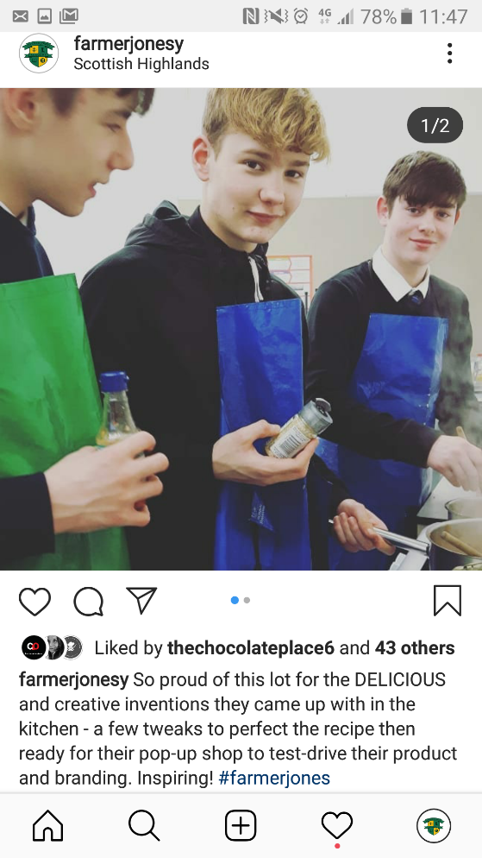
From Seed to Sale
SCQF Level 5
Notes:
Sarah

Slide 15
Community Project Award
SCQF Level 5
50 - S6 taking part
10-15 S3,4,5 alternative curriculum model
.
Notes:
Sarah

Slide 16
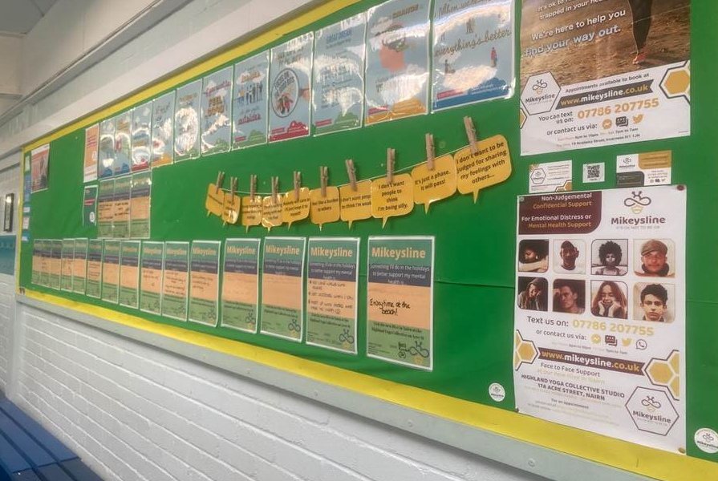
Project: Mikey’s Line
Mental Health Charity
The pupil is an ambassador for the charity
Aim: To raise awareness of support available for mental health
Notes:
Sarah

Slide 17
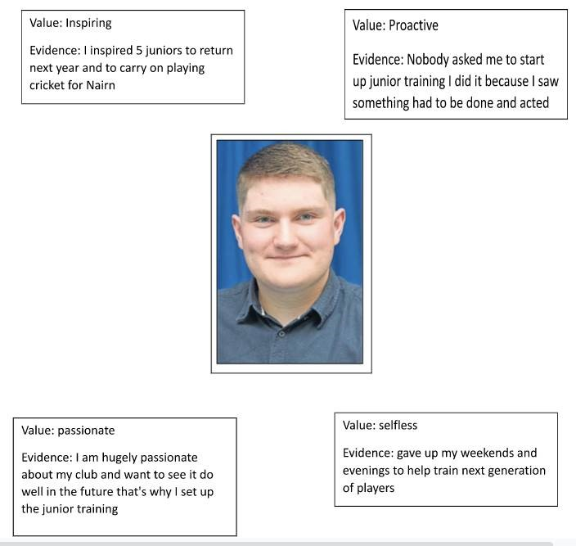
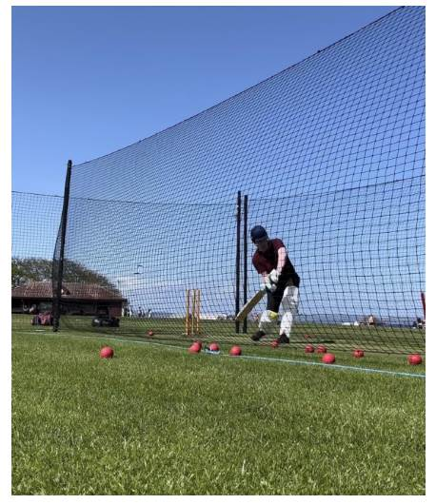
Project: Nairn County Cricket Club, Junior Training
Notes:
Sarah

Slide 18
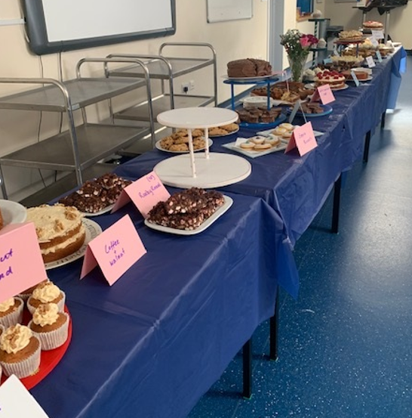
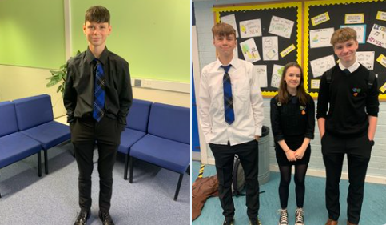
Heat & Treat Project
Notes:
Sarah

Slide 19
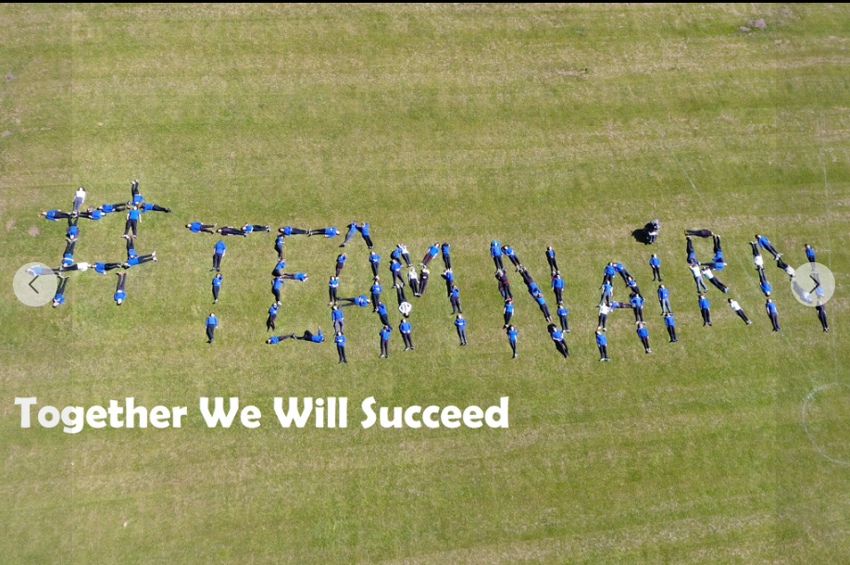
Next steps…
Continue to look for opportunities to work between UHI Inverness and local industry
Notes:
Sarah

Slide 20
What Questions do you have? Thanks Moran-taing

